Slide 1


Slide 2

Major Project-I (01CE0716)
Semester 7
Review 1 (11/07/2026)
IntelliQ: Smart Queue Prediction System
Team ID: 7P_124
Team Member 1: Devicharan Dasari (9410103020) (7EC3)
Team Member 2: Smit Rudakiya (92410103019) (7EC3)
Team Member 3: Adityaraj Chudasama (92410103051) (7EC3)
Guided By
Internal Guide
Professor Viraj Daxini
Department of Computer Engineering, Faculty of Engineering & Technology

Slide 3
Outline
Introduction
Abstract
Problem Statement
Objective
Current Existing Problems & Solutions
Existing System vs Proposed System
Screenshot
Future Enhancements
Conclusion
References

Slide 4
Introduction
Traditional queue systems lead to long waiting times and uncertainty. Our AI-based solution predicts waiting time and recommends the best reservation slot for hospitals, banks, restaurants and colleges.
What is IntelliQ?
IntelliQ is a state-of-the-art smart queue prediction and management system. It aims to bridge the gap between physical queues and remote convenience by leveraging advanced digital tools and machine learning forecasts.
Multi-Role SaaS Architecture:
The system is structured as a SaaS (Software-as-a-Service) multi-tenant platform featuring 4 customized roles: regular Users, Organization Admins, Counter Staff, and Platform Super Admins.
Solving Real-World Crowding:
Hospitals and Banks suffer from severe wait times. IntelliQ addresses this by enabling live queue status tracking, virtual QR token bookings, and smart scheduling recommendations.

Slide 5
Abstract
Core Mission
IntelliQ is a full-stack digital platform designed to completely eliminate physical queue wait times at critical public service centers.
AI Predictor
Uses ML models (Random Forest Regressor / Linear Regression) to predict time-slot crowd densities based on historical datasets.
Contactless Check-In
Generates dynamic QR-code based digital tokens to allow fast, paperless arrivals at physical counters.
Robust Architecture
Built with Flutter (Dart) for Android and Web. The backend is a .NET 8 ASP.NET Core REST API connected to SQL Server. and a Python Machine Learning engine for intelligent queue prediction.
Provider Autonomy
Empowers admins to customize counter counts, define operational services, and monitor staff efficiency remotely.
Seeded Datasets
Comes pre-packaged with a vast dataset of 1L+ real Indian locations across key domains (banks, colleges, hospitals).

Slide 6
Problem Statement
Users do not know expected waiting time, organizations face overcrowding during peak hours, and manual queue systems reduce efficiency and customer satisfaction.
Massive Time Waste Daily
People waste hours standing in lines at doctors, banks, and government offices every day.
No Idea of Wait Times
People cannot see how long the line is or how much time it will take before they reach the place.
Paper Tokens are Inconvenient
Paper slips get lost easily, cannot be tracked from home, and waste paper.
No Crowd Control tools
Managers have no data tools to decide when to open extra counters or how to balance the crowd.
Time Loss
Millions of hours are lost by citizens waiting for basic services.
Zero Visibility
No way to check token position or wait list numbers remotely.
Peak Crowds
Heavy rush at specific morning hours causing extreme delays.

Slide 7
Objectives
Predict Waiting Time: Estimate customer waiting time using Al and machine learning.
Provide Smart Reservation: Recommend the best time slots based on predicted queue conditions.
Reduce Overcrowding: Distribute customer visits to minimize congestion during peak hours.
Improve User Experience: Provide real-time queue updates and faster, more convenient service.
Support Multiple Industries: Develop a scalable solution for hospitals, banks, restaurants and colleges.
Future Enhancement: Enable automatic queue monitoring using CCTV and computer vision

Slide 8
Current Existing Problems & Solutions
2. Appointment Schedulers
PROBLEM: Traditional calendar slots (Google) ignore actual counter queues. If counters run late, users wait physically. ✔ INTELLIQ SOLUTION: Merges live queue counters with time slots. Automatically adjusts queue estimates based on real-time counter updates.
3. Domain-Specific Systems
PROBLEM: Most applications support only hospitals or only banking portals, requiring multiple separate apps. ✔ INTELLIQ SOLUTION: Unified cross-domain ecosystem. Handles Hospital consultations, Bank cash desks, restaurants wait queue, and Govt certificate offices within a single application.
1. Physical Queue Devices
PROBLEM: Requires expensive hardware displays at physical venues. No mobile remote access. ✔ INTELLIQ SOLUTION: Purely cloud-software driven. Users track live queues directly on their mobile/web browser from anywhere, eliminating hardware costs completely.
IntelliQ combines virtual tokens, live updates, and ML recommendations to resolve all three core system shortcomings in one clean codebase.

Slide 9
Existing System vs Proposed System
Aspect | Existing Systems | IntelliQ (Proposed)
Scope / Domains | Single-domain apps (hospitals only OR banks only) | Unified multi-domain (Hospital, Bank, Govt, College, Resto)
Queue Updates | Manual slip numbers or slow SMS alerts | Live, real-time interactive queue tracking on UI
Smart Forecasting | Absent. No scheduling recommendations | AI-scored time slots displaying expected crowd density levels
Contactless Entry | Paper ticket slips / manual logs | Contactless check-in using unique QR-code tokens
Tenant Roles | Basic client only — no counter-level operations | 4 distinct roles: User, Staff, Admin, and Super Admin dashboards
Geolocation Cost | Relies heavily on paid Google Maps APIs | Autonomous lookup using pre-loaded 1L+ location coordinates

Slide 10
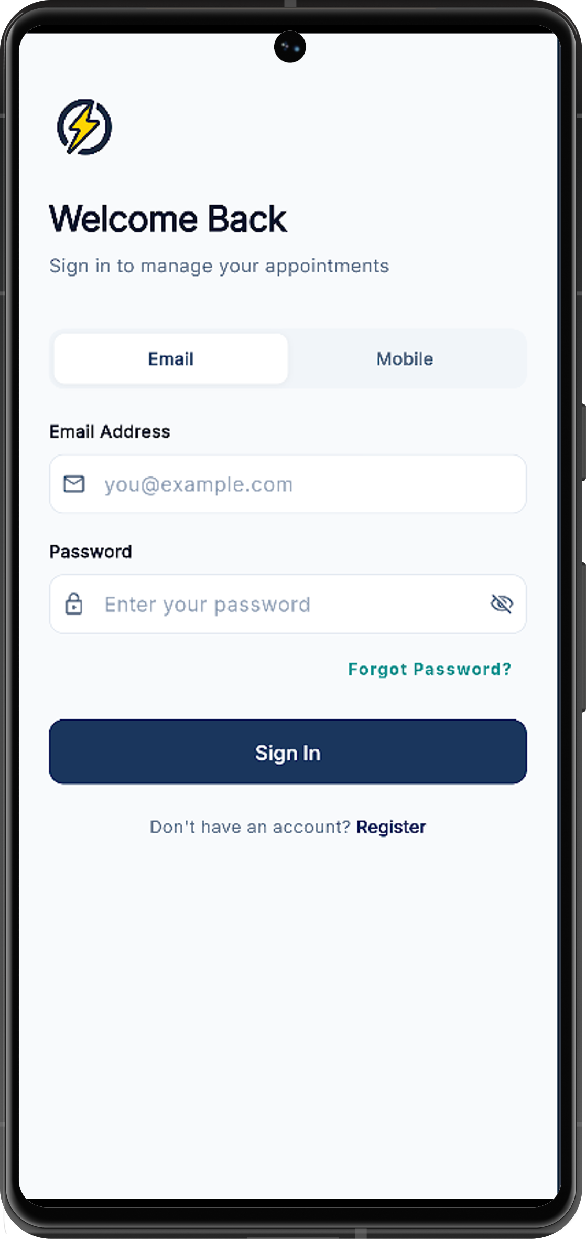
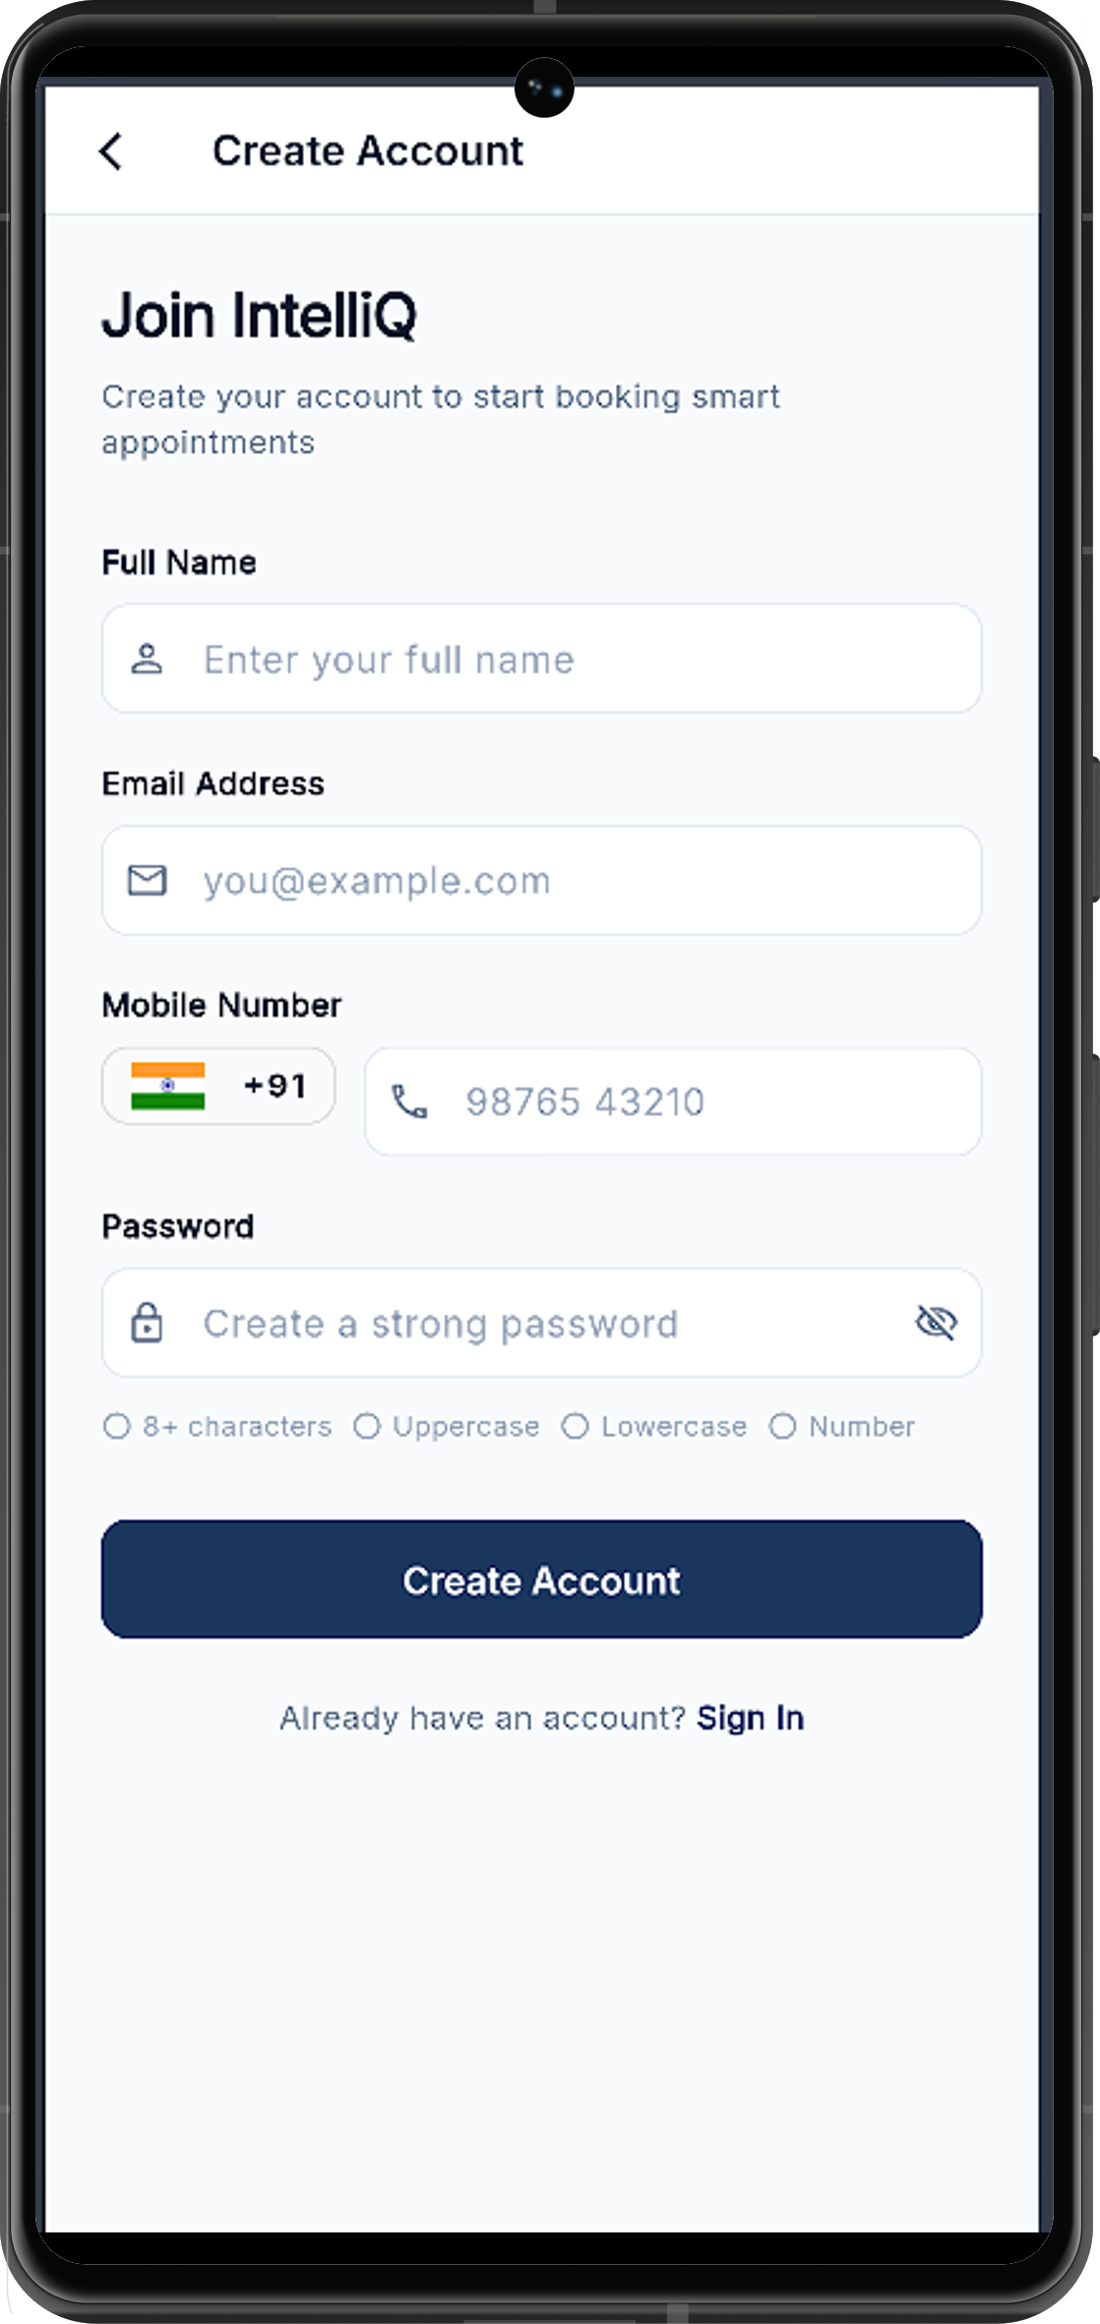
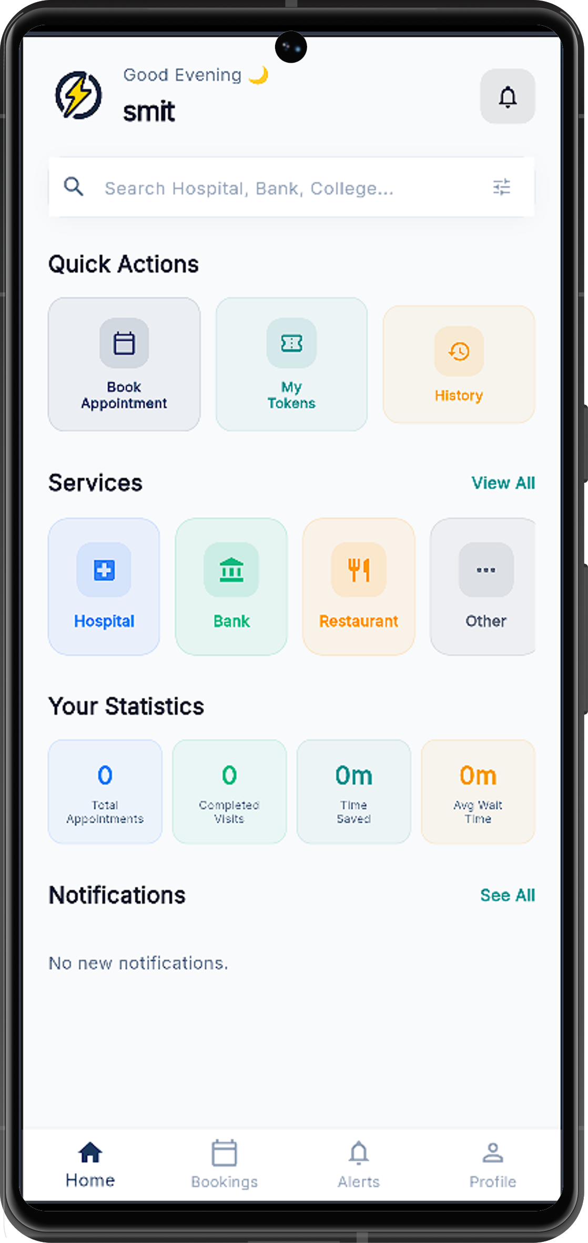
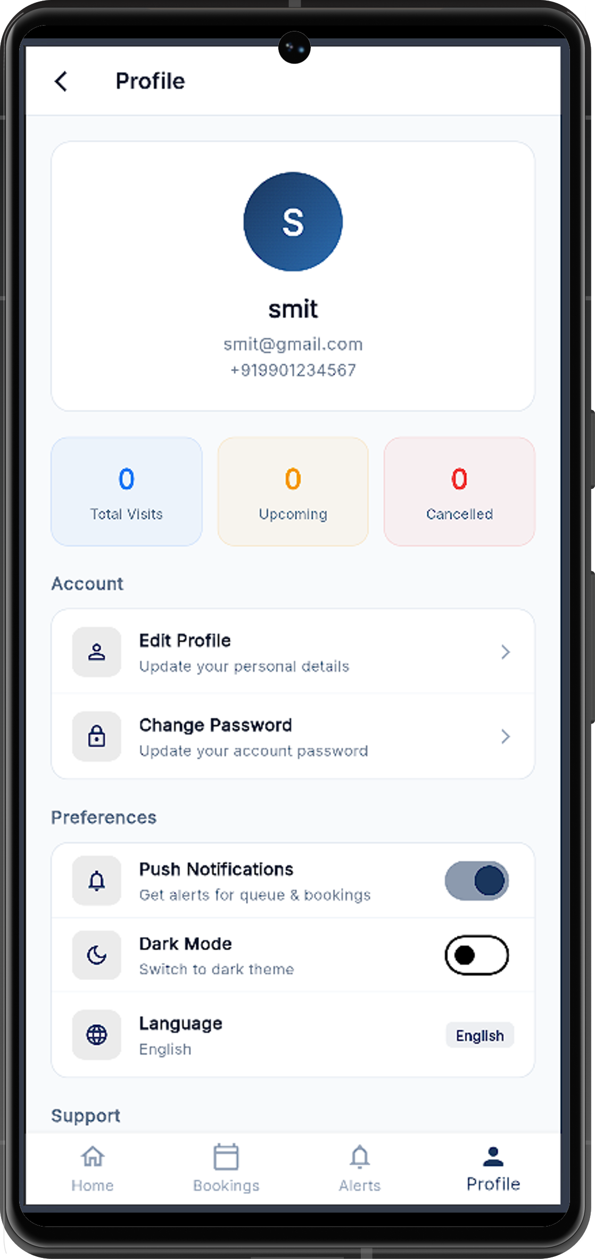
Screenshot
User Panel

Slide 11
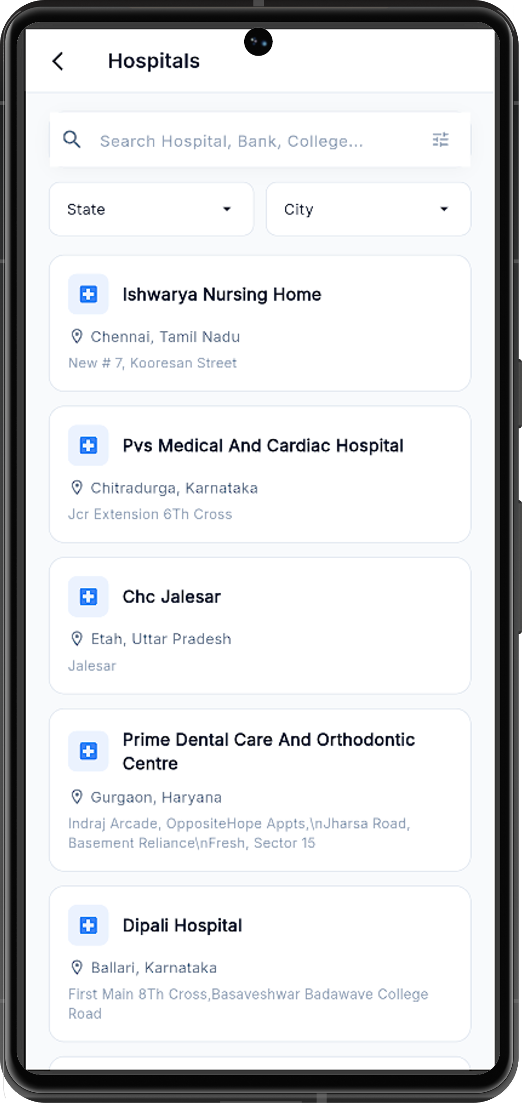
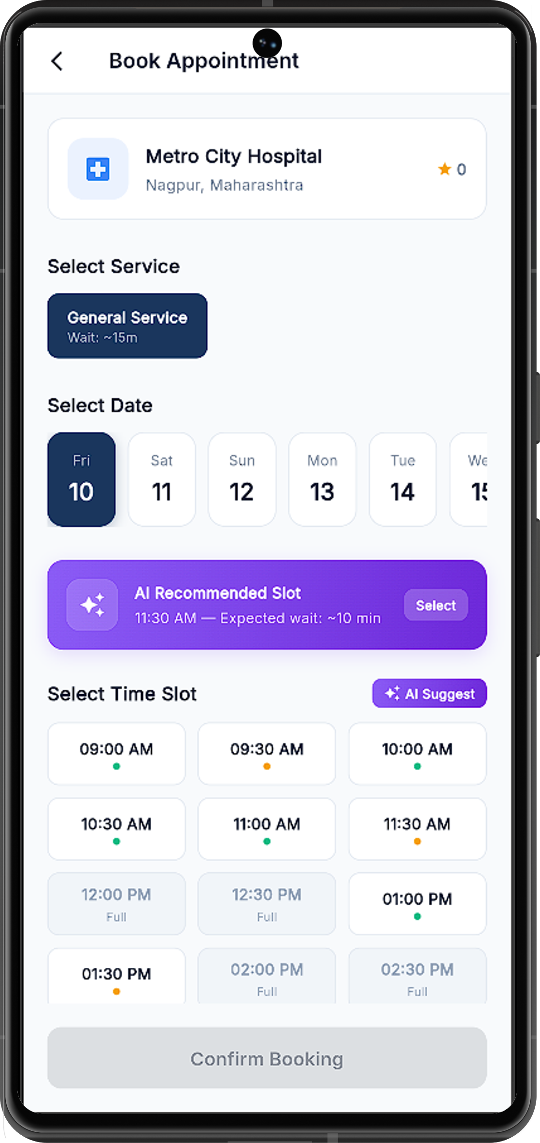
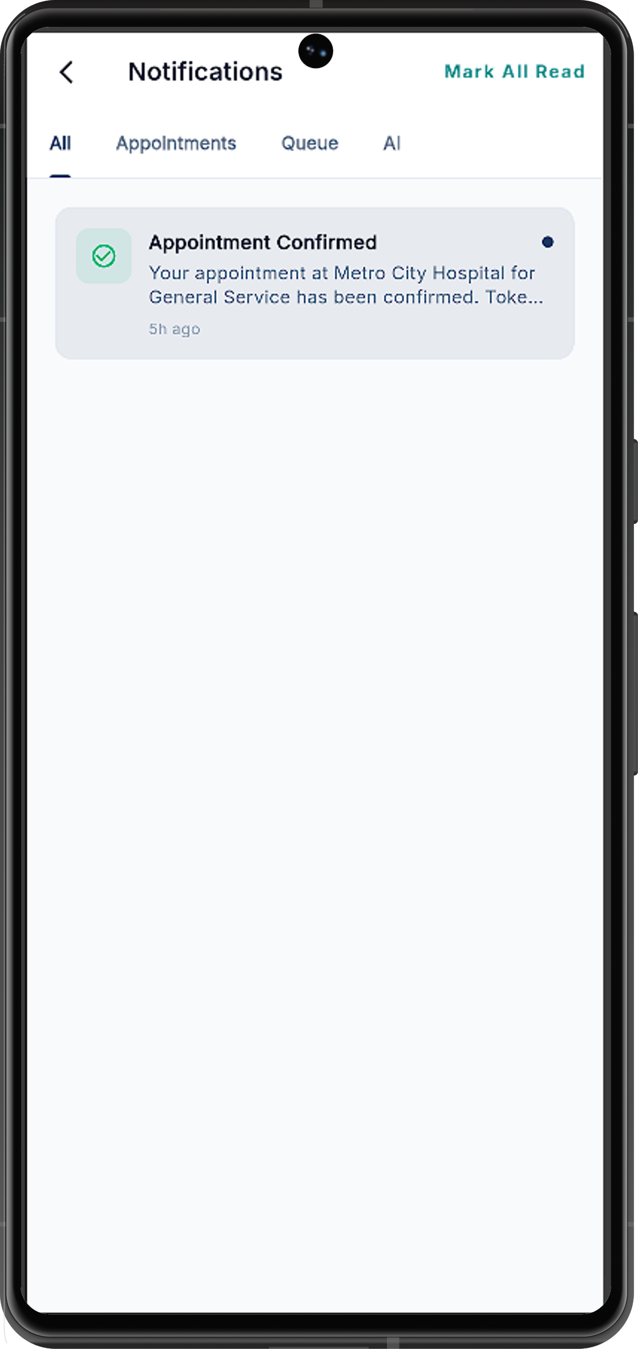
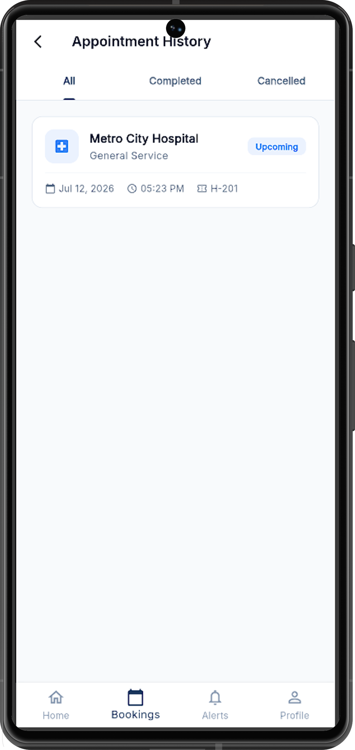
Screenshot
User Panel

Slide 12
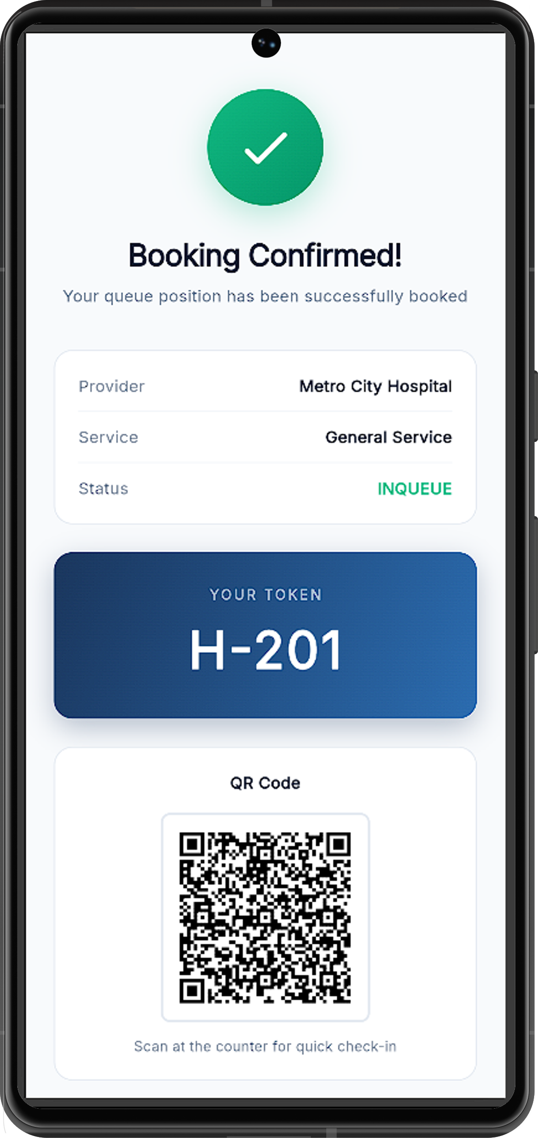
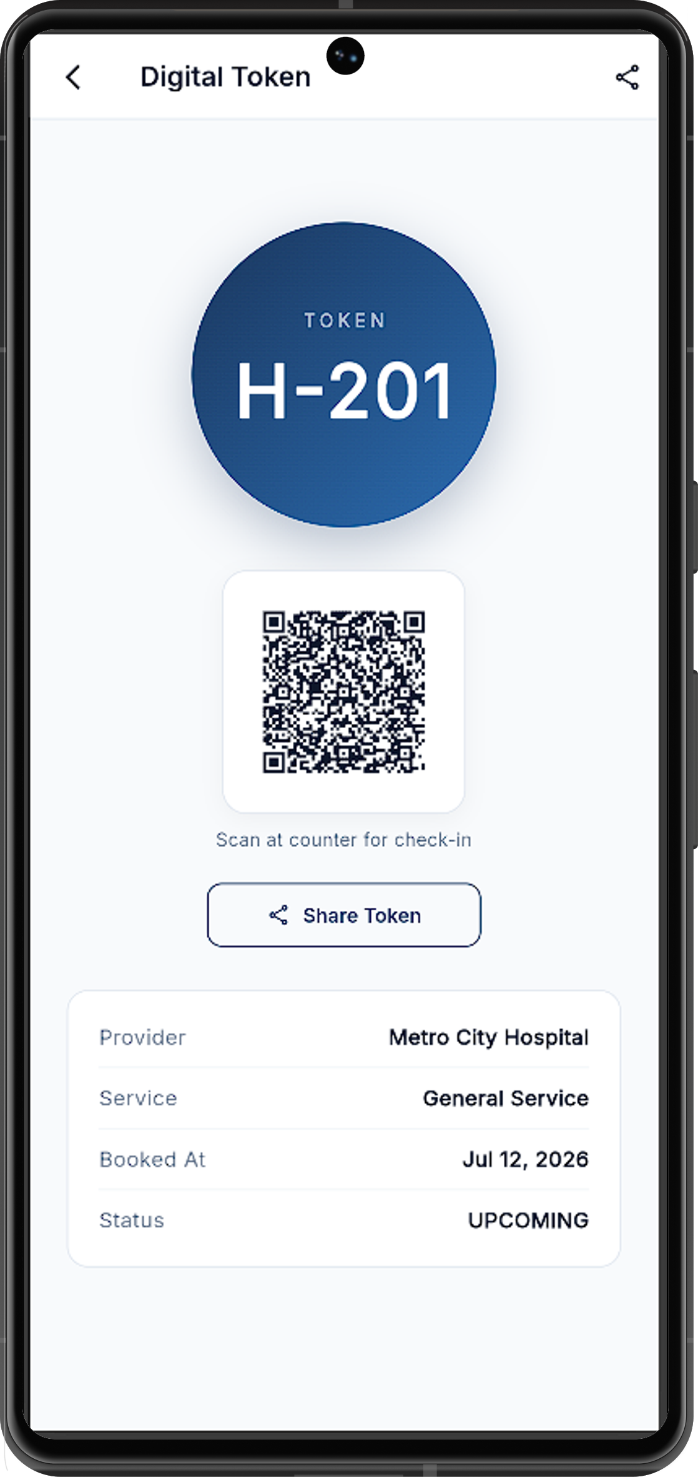
Screenshot
User Panel

Slide 13
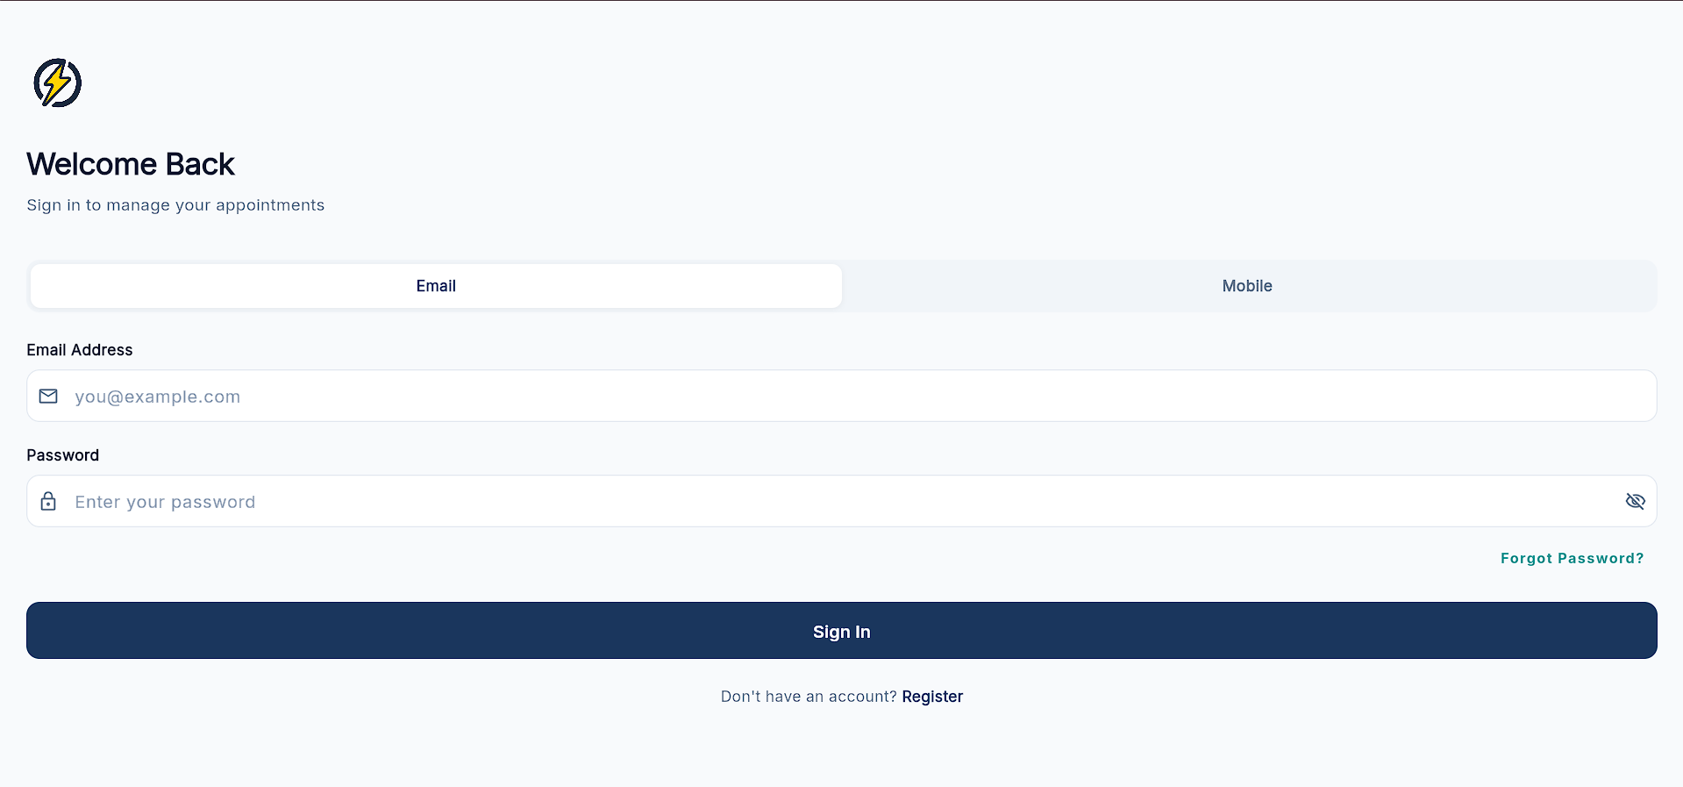
Screenshot
Staff

Slide 14
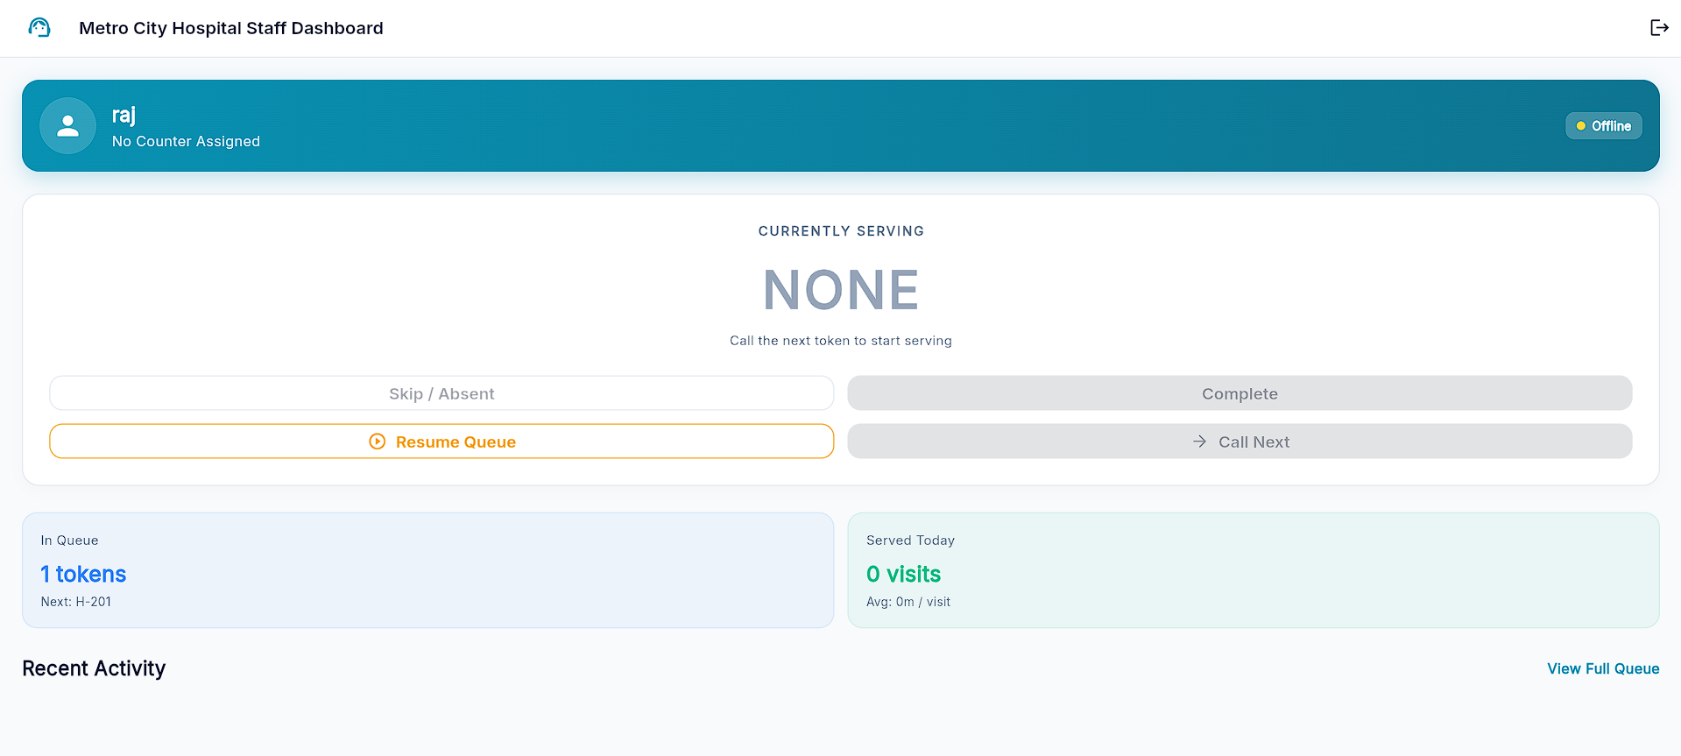
Screenshot
Staff

Slide 15
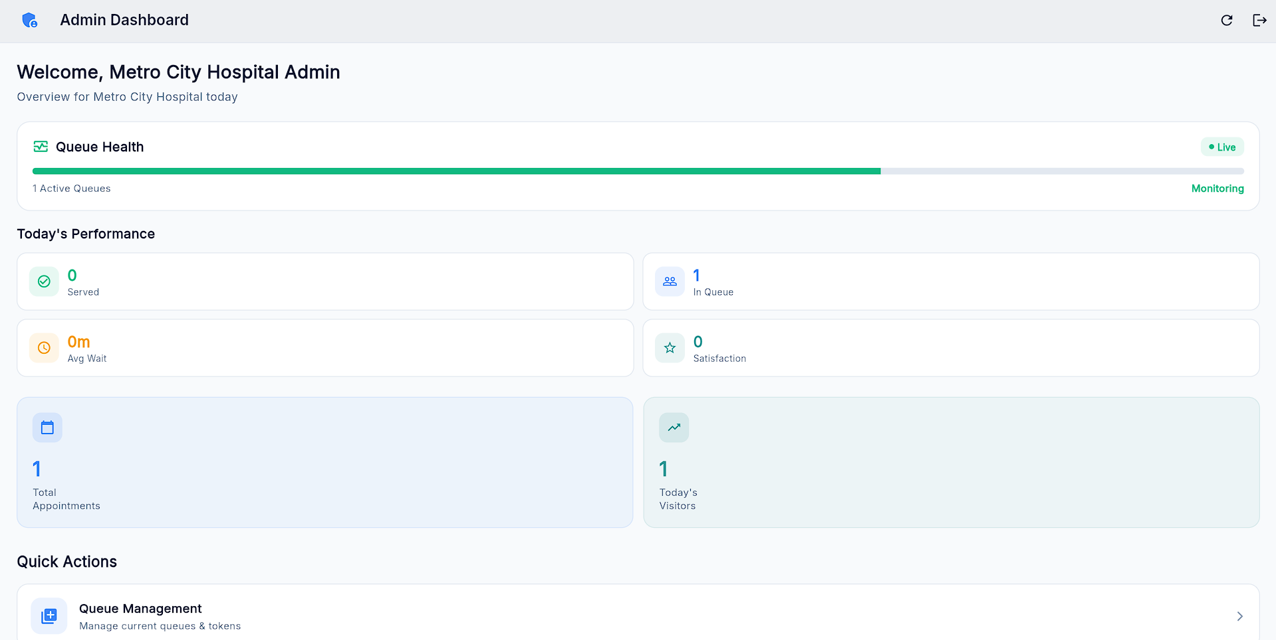
Screenshot
Local Admin

Slide 16
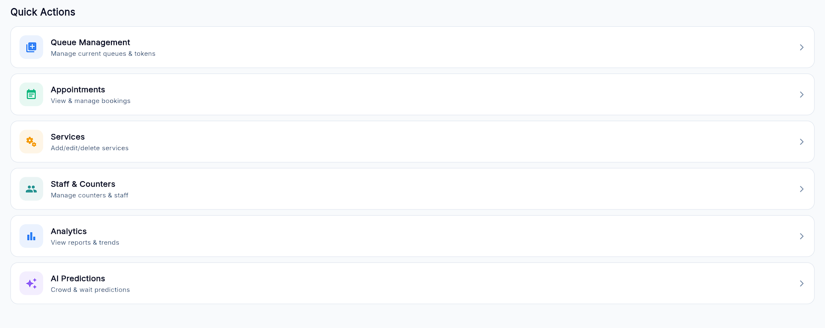
Screenshot
Local Admin

Slide 17
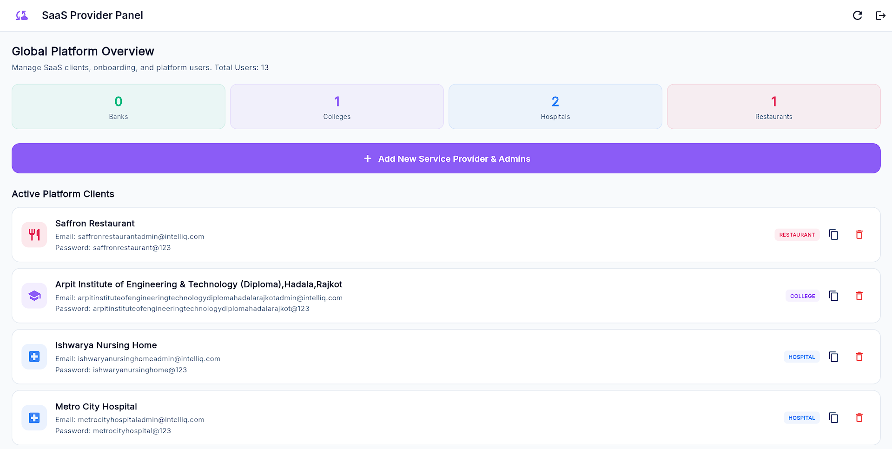
Screenshot
Super Admin

Slide 18
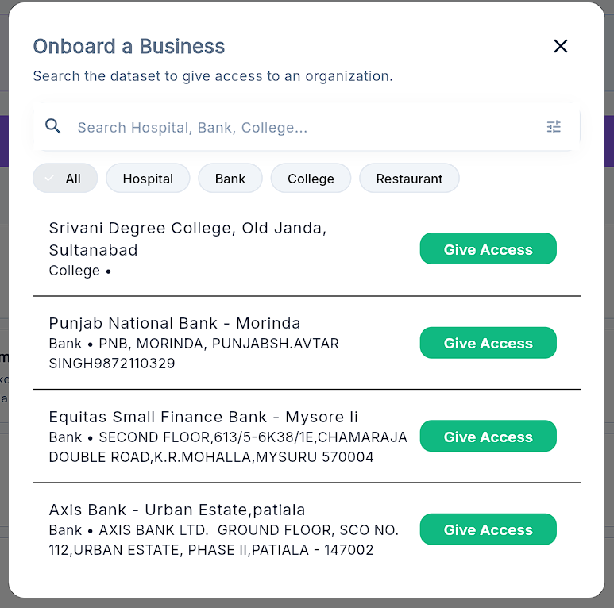
Screenshot
Super Admin

Slide 19
Future Enhancements
Local Language Support
Translate the mobile and web screens to local Indian languages (Hindi, Telugu, etc.) so that all citizens can read and use the app easily.
Train ML Model
Develop and optimize machine learning models using real-world data to improve queue prediction performance.
Smart Mobile Push Alerts
Integrate Firebase to alert users via sound alerts when their turn is 3 positions away. Saves users from constantly keeping the app screen open.
Cloud Deployment & CI/CD
Deploy the application on Azure or AWS with a CI/CD pipeline for automated deployment, improved scalability, and reliable software updates.

Slide 20
Conclusion
The system improves queue management using AI prediction, smart booking and scalable architecture.
Smart Booking & QR
Replaces manual paperwork with quick QR tokens. Users join the line remotely and get real-time wait estimates on their screens.
Smart AI Prediction
Guiding users to pick empty hours significantly flattens peak crowds. Instead of rushing at 10 AM, users are spread throughout the day.
Scalable Multi-Tenant Setup
Designed using clean role-based dashboards (User, Staff, Admin). Handles multiple industries and locations with low server load.
Budget-Friendly & Ready
Pre-seeded database of 1L+ real locations removes map API costs, making it easily deployable for local Indian public services.

Slide 21
Project Development Progress
70%
COMPLETED
1
2
3
4
Stage 1
Stage 2
Stage 3
Stage 4
Literature Review & Problem Analysis
Technology Selection (Flutter, ASP.NET, Python)
Dataset Collection & Research
System Requirement Analysis
GitHub Repository Setup
Flutter UI Design
Login & Registration
Queue Booking Interface
Reservation Module
User Dashboard
ASP.NET Core REST API
SQL Server Database
Authentication & Authorization
API Integration
Database Management
Dataset Preprocessing
Feature Engineering
Model Training Model Evaluation
Python Prediction API
End-to-End Testing
Performance Optimization

Slide 22
References
Flutter Docs: https://docs.flutter.dev/
ASP.NET Core Docs: https://dotnet.microsoft.com/en-us/apps/aspnet and
https://learn.microsoft.com/en-us/aspnet/core/?view=aspnetcore-10.0
Scikit-learn: https://scikit-learn.org/stable/
Python Docs: https://docs.python.org/3/
Kaggle: https://www.kaggle.com/

Slide 23
Q&A

Slide 24


